Slide 1
IT304 Computer Networks Week8-Lec2
Network layer Fundamentals

Slide 2
Two key network-layer functions
network-layer functions:
forwarding: move packets from a router’s input link to appropriate router output link
routing: determine route taken by packets from source to destination
routing algorithms

Slide 3
IP Protocol

Slide 4

IP addressing: introduction
223.1.1.1
IP address: 32-bit identifier associated with each host or router interface
interface: connection between host/router and physical link
router’s typically have multiple interfaces
host typically has one or two interfaces (e.g., wired Ethernet, wireless 802.11)
223.1.2.1
223.1.1.2
223.1.1.4
223.1.2.9
223.1.1.3
223.1.3.27
223.1.2.2
223.1.3.1
223.1.3.2
dotted-decimal IP address notation:
223.1.1.1 = 11011111 00000001 00000001 00000001
223
1
1
1

Slide 5
Example Of Dotted Decimal
Notation
A 32-bit number in binary
10000000 00001010 00000010 00000011
The same
notation
32-bit
number expressed in
dotted
decimal
128 . 10 . 2 . 3

Slide 6
What comprises an IP address?
Break the bunch of bits into 4 parts (8 bits each)
11000000. 10101000.01111011.10000100
Subnet Mask: local or remote network?
11000000.10101000.01111011.10000100
11111111. 11111111. 11111111. 00000000
-------------------------------------------------------
11000000. 10101000. 01111011.00000000
------------------------------------------------------
Network part: 192.168.123.0 (all 1s in the mask)
Host part:0.0.0.132 (all 0s in the mask)
Set of decimal numbers
192.168.123.132
What can we understand from this?
NOTHING
How do routers interpret this decimal number?
Set of binary digits
1100000010101000111101110000100
Can we make sense of it now?

Slide 7
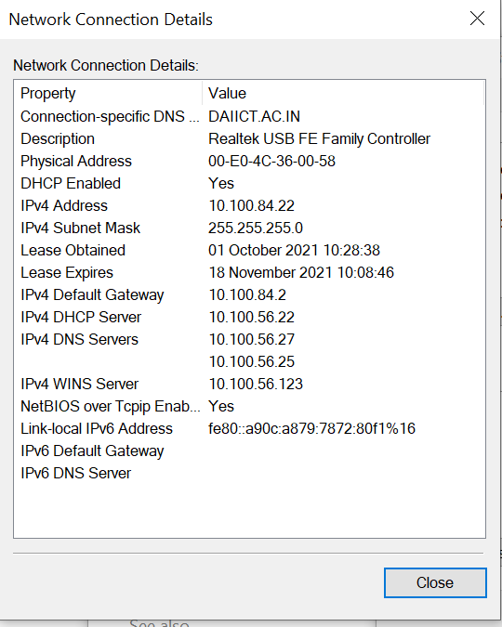
What is an IP address?

Slide 8
How does a router move packets from a it’s input link to an appropriate

Slide 9
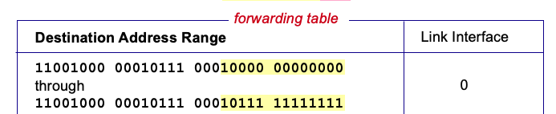
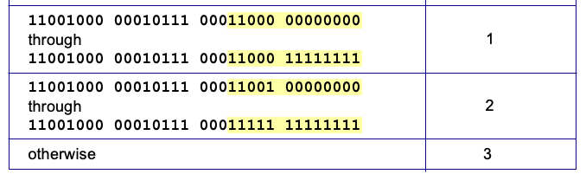
Destination-based forwarding
Notes:
Text for this animation:
This all works out pretty nice and looks pretty simple!
But of course the devil is in the details, as the saying goes.
What happens, for example, when a subset of addresses say in this first range should go to say interface 3, rather than interface 0. Well, of course we could split the first address range into multiple pieces, and add in this new subrange with its new destination output port. But it turns out there’s a much simpler and elegant way to do this. Known as longest prefix matching.

Slide 10
Longest prefix matching
longest prefix match
when looking for forwarding table entry for given destination address, use longest address prefix that matches destination address.
Destination Address Range
11001000 00010111 00010
11001000 00010111 00011000
11001000 00010111 00011
otherwise
Link interface
0
1
2
3
***
********
********
***
********
examples:
11001000 00010111 00010110 10100001
which interface?
11001000 00010111 00011000 10101010
which interface?

Slide 11
Longest prefix matching
Destination Address Range
11001000 00010111 00010
11001000 00010111 00011000
11001000 00010111 00011
otherwise
Link interface
0
1
2
3
***
********
********
match!
***
********
examples:
11001000 00010111 00010110 10100001
which interface?
11001000 00010111 00011000 10101010
which interface?

Slide 12
Longest prefix matching
Destination Address Range
11001000 00010111 00010
11001000 00010111 00011000
11001000 00010111 00011
otherwise
Link interface
0
1
2
3
***
********
********
***
********
match!
examples:
11001000 00010111 00010110 10100001
which interface?
11001000 00010111 00011000 10101010
which interface?

Slide 13
Longest prefix matching
Destination Address Range
11001000 00010111 00010
11001000 00010111 00011000
11001000 00010111 00011
otherwise
Link interface
0
1
2
3
***
********
********
***
********
match!
examples:
11001000 00010111 00010110 10100001
which interface?
11001000 00010111 00011000 10101010
which interface?

Slide 14
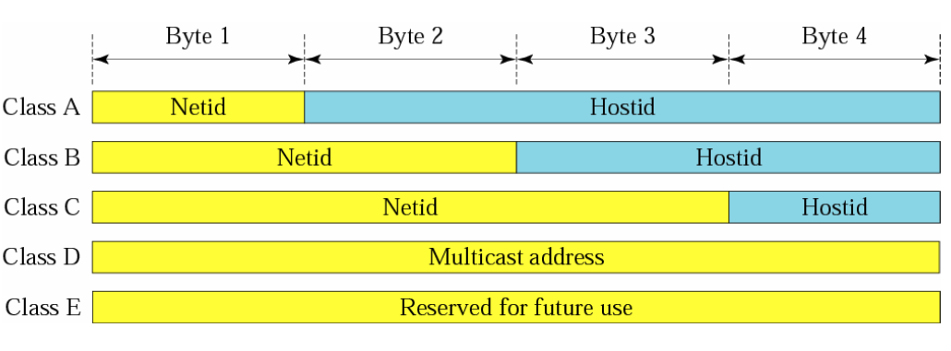
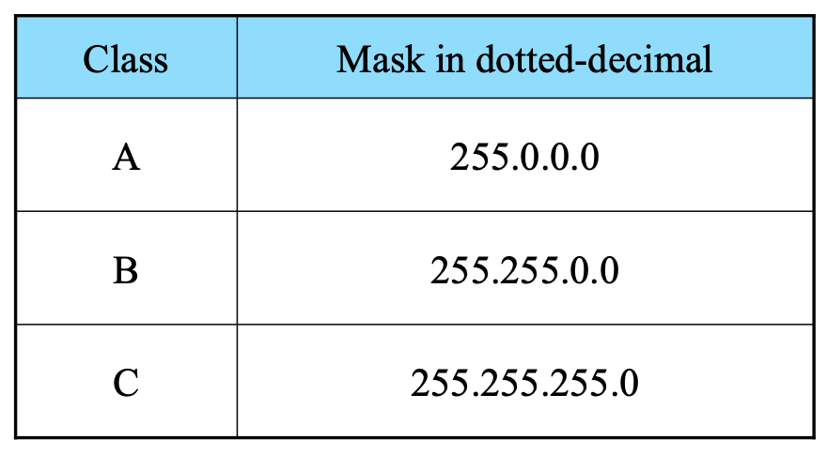
Classes in IP addresses
Number of networks
Number of hosts
Class
Lowest Address
Highest Address
A
B
C
D
E
1.0.0.0
128.1.0.0
192.0.1.0
224.0.0.0
240.0.0.0
126.0.0.0
191.255.0.0
223.255.255.0
239.255.255.255
255.255.255.254

Slide 15
Subnets
223.1.1.1
What’s a subnet ?
device interfaces that can physically reach each other without passing through an intervening router
223.1.2.1
223.1.1.2
223.1.1.4
223.1.2.9
223.1.1.3
223.1.3.27
223.1.2.2
IP addresses have structure:
subnet part: devices in same subnet have common high order bits
host part: remaining low order bits
223.1.3.1
223.1.3.2
network consisting of 3 subnets

Slide 16
Subnets
subnet 223.1.1.0/24
223.1.1.1
subnet 223.1.2.0/24
Recipe for defining subnets:
detach each interface from its host or router, creating “islands” of isolated networks
each isolated network is called a subnet
223.1.2.1
223.1.1.2
223.1.1.4
223.1.2.9
223.1.1.3
223.1.3.27
223.1.2.2
subnet
223.1.3.0/24
223.1.3.1
223.1.3.2
subnet mask: /24
(high-order 24 bits: subnet part of IP address)

Slide 17
Subnets
223.1.1.2
subnet 223.1.1/24
where are the subnets?
what are the /24 subnet addresses?
223.1.1.1
223.1.1.4
223.1.1.3
223.1.9.2
223.1.7.0
subnet 223.1.7/24
subnet 223.1.9/24
223.1.9.1
223.1.7.1
223.1.8.1
223.1.8.0
subnet 223.1.2/24
223.1.2.6
subnet 223.1.8/24
223.1.3.27
subnet 223.1.3/24
223.1.2.1
223.1.2.2
223.1.3.1
223.1.3.2

